Slide 1
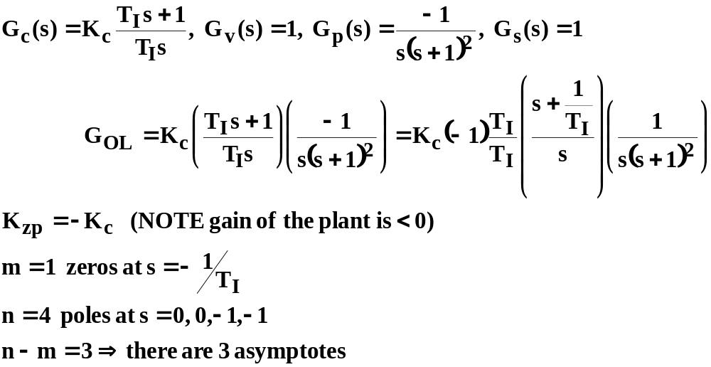
EXAMPLE 4: PI control with 3-asymptotes step 1: put in required form, identify poles, zeros number of asymptotes:

Slide 2
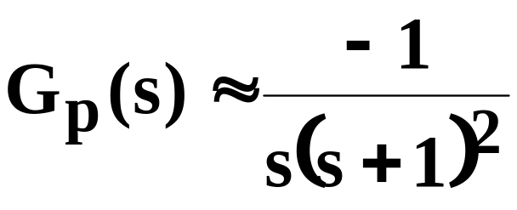
EXAMPLE 4: PI control with 3-asymptotes
Step 5: sketch possible locus as |K_{zp}| is increased with T_{I}=2
UNSTABLE for K_{c} too negative
X
X
O
X
X
REVERSE response plant needs REVERSE action controller (K_{c}<0)

Slide 3
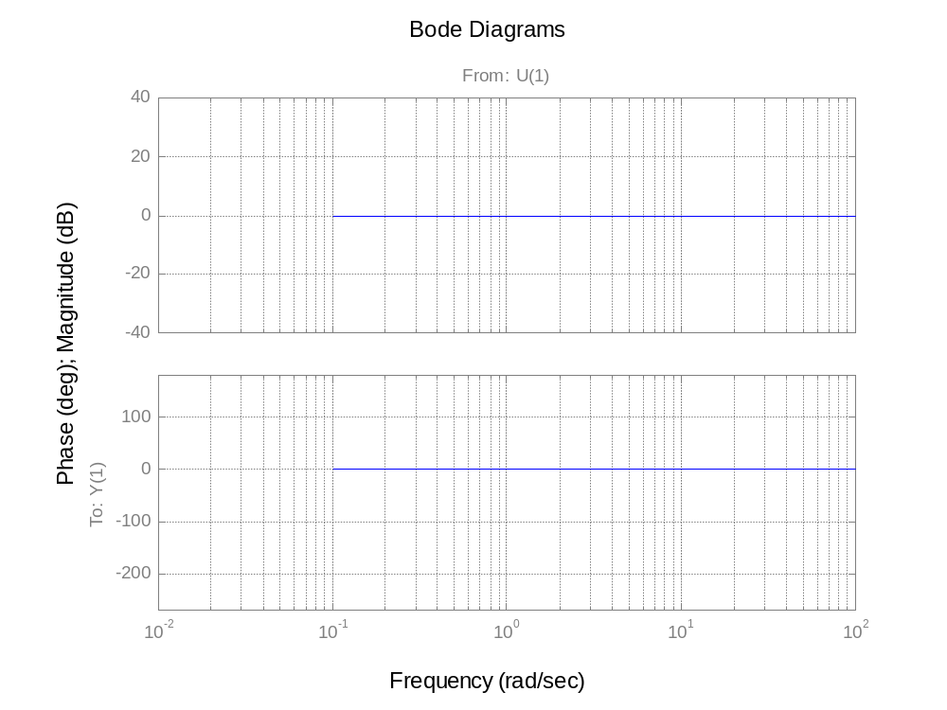
Adding PI controller components together
20+40=60
Slope=-20
ω_{b}=1/T_{I}=10
Slope=-20+20=0
Slope changes by +20db decade at the break
Twice as many slope changes on phase plots because two “corners” per break
.01
.1
1
10
100

Slide 4
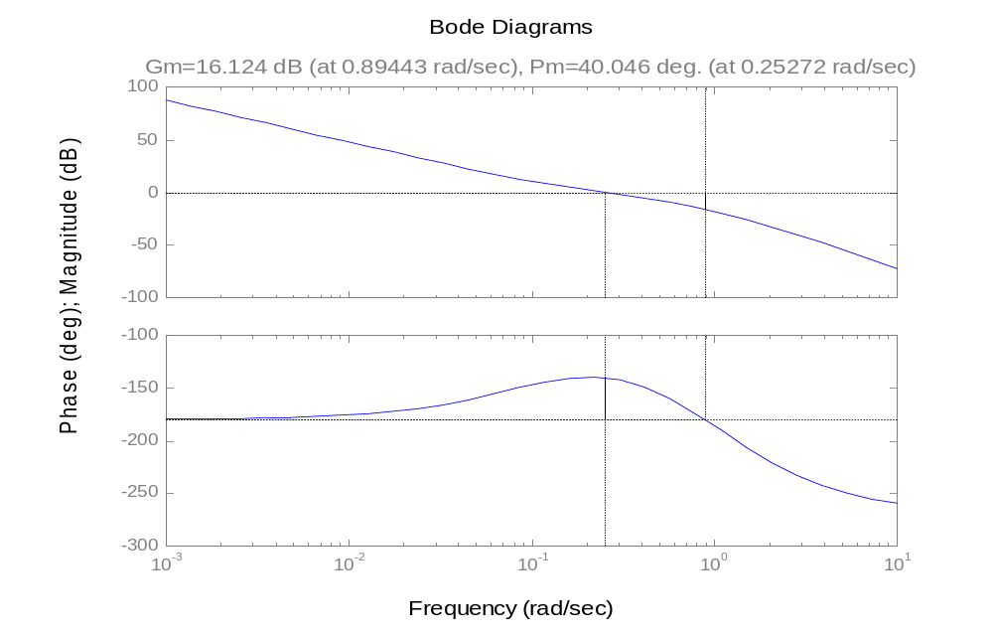
margin(0.25*[10 1],conv([10 0],[1 2 1 0]))
Gm=16 db, Pm=40º

Slide 5
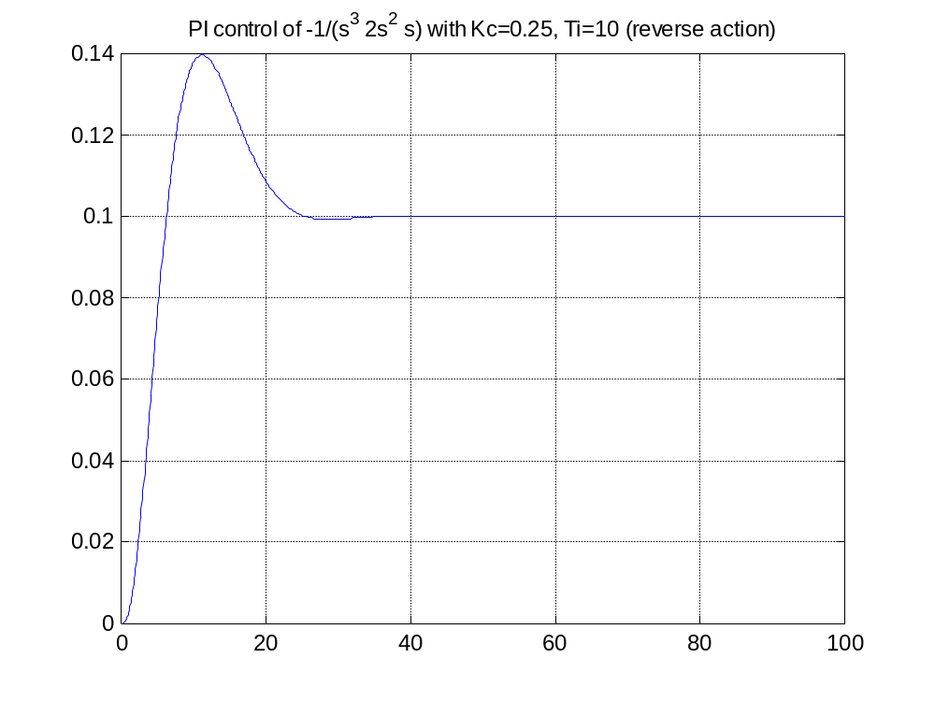
Response of PI of 1/[s(s^2 +1)]

Slide 6
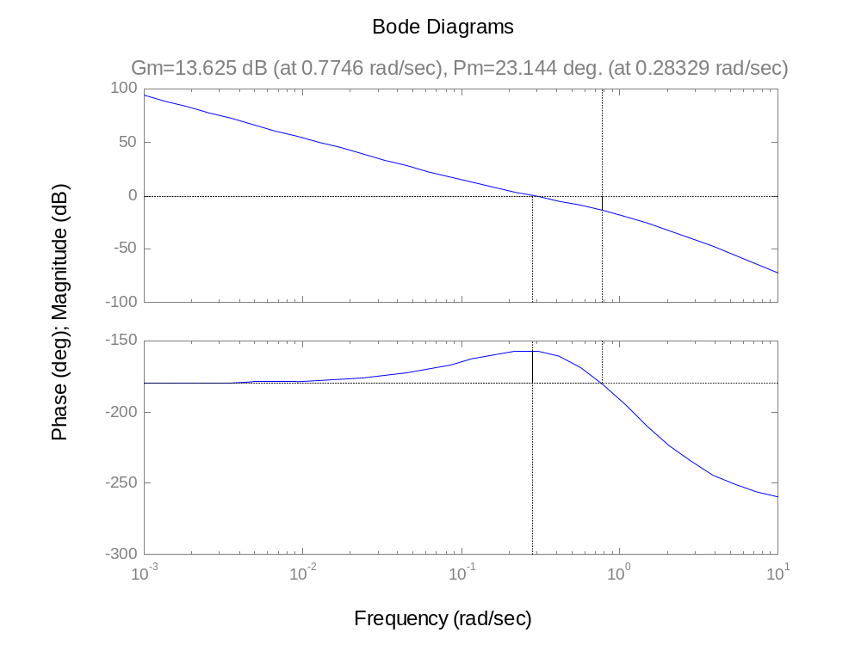
margin(0.25*[5 1],conv([5 0],[1 2 1 0])) maximum phase margin only 23º because the reset time is too short T_{I}=5

Slide 7
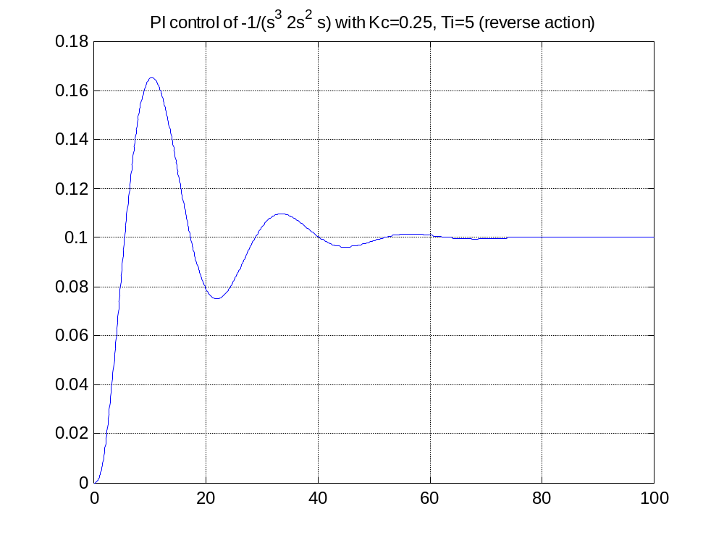
Response with T_{I}=5, K_{c}=0.25 and poor phase margin

Slide 8
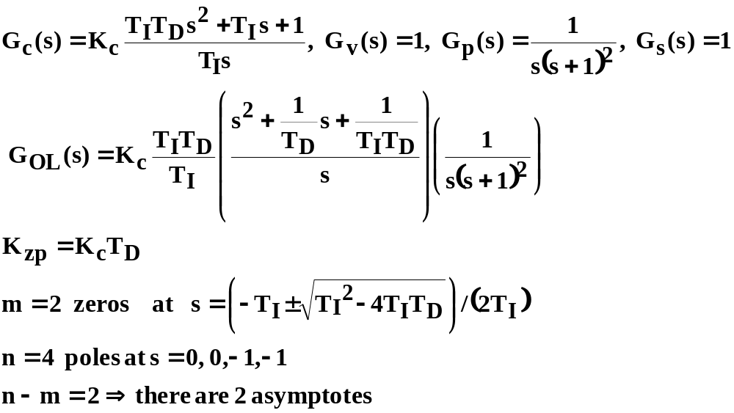
EXAMPLE 5: PID control with 3rd order plant step 1: put in required form, identify poles, zeros number of asymptotes:

Slide 9
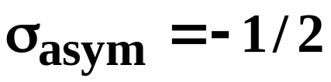
EXAMPLE 5: PID control with 3rd order plant
Step 5: sketch possible locus as |K_{zp}| is increased with T_{I}=4,T_{D}=1
s-plane
STABLE RESPONSE FOR FOR ALL K_{c}
X
X
O
O
X
X
Addition of T_{D} requires change in T_{I}

Slide 10
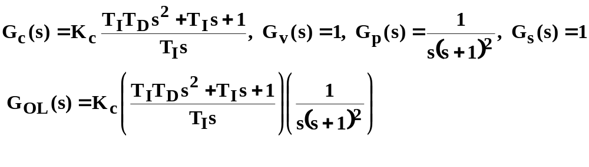
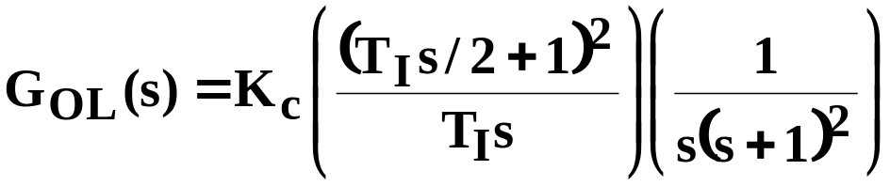
BODE ex 3: PID control with 3rd order plant step 1: put in required form, identify break frequencies and characterisitics of all components
As a first example choose T_{I} and T_{d} to get a repeated numerator root. T_{d}=T_{I}/4 and the repeated time constant is = T_{I}/2

Slide 11
PID controller (T_{i}s/2+1)²/T_{I}s portion; T_{I}=20
|(10s+1)²|
|1/s|
|1/20|=-26db
L[ (10s+1)²]
L[1/s]
L 1/20
.01
.1
1
10
100

Slide 12
PID controller components added together
40-26=
14db
Increasing gain at large ω creates noise response problem
Ultimate Phase Improvement of +90º
.01
.1
1
10
100

Slide 13
1/[s(s+1)²] and PID controller T_{I}=20, T_{D}=5
40+14= 54 db
1/T_{I}=.1
1/[s(s+1)²]
-60db/ dec
PID= control
30º PM
.01
.1
1
10
100

Slide 14
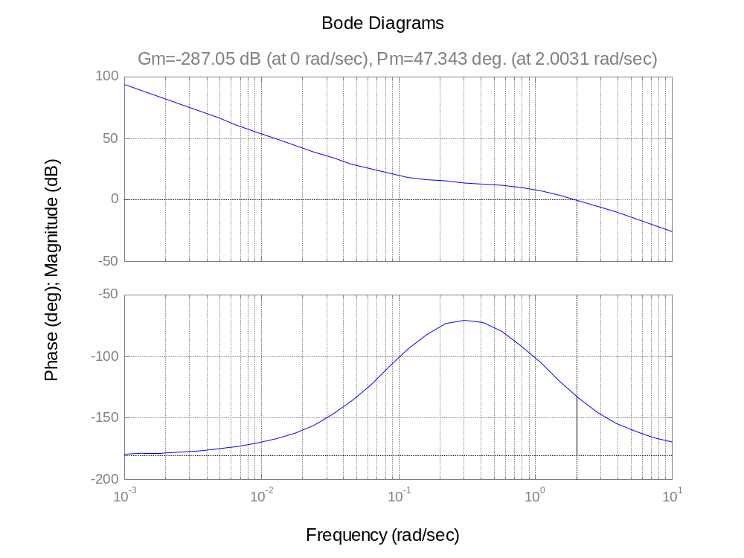
margin([5*20 20 1],conv([20 0],[1 2 1 0]))
Pm=47º, GM= infinite, Kc=1
ω₁~2

Slide 15
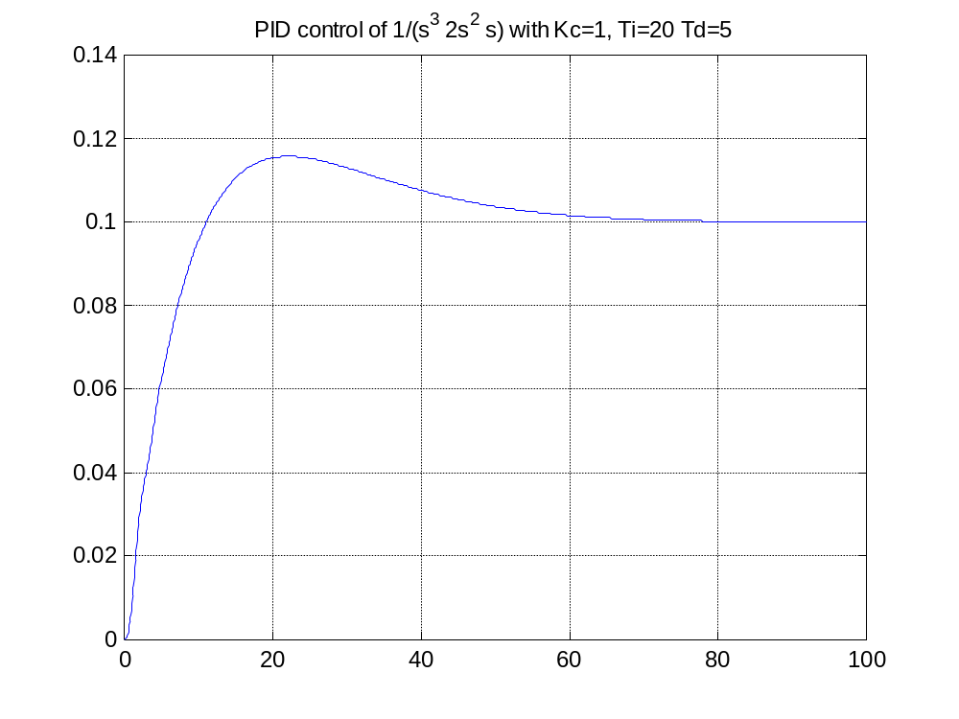
PID Response 1/[s(s+1)²],
Kc=1, T_{I}=20, T_{D}=5

Slide 16
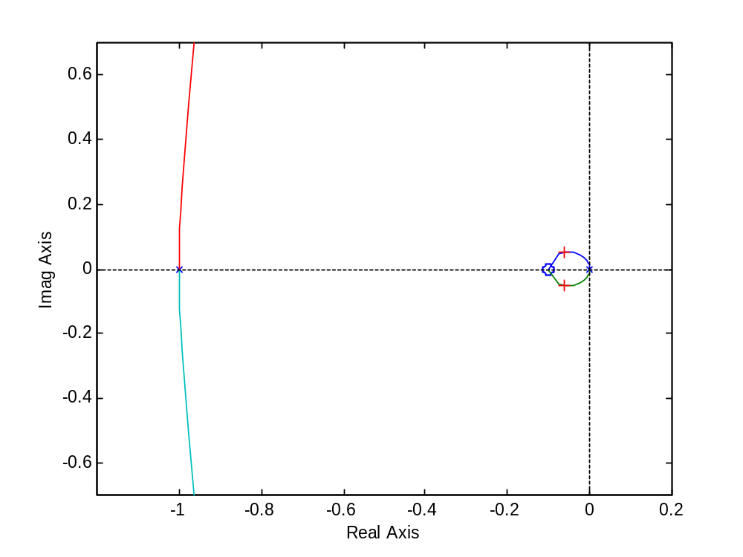
rlocus([5*20 20 1],conv([20 0],[1 2 1 0]))
Kc=0.28
Placing PID zeros close to the origin forces a slow closed loop response

Slide 17
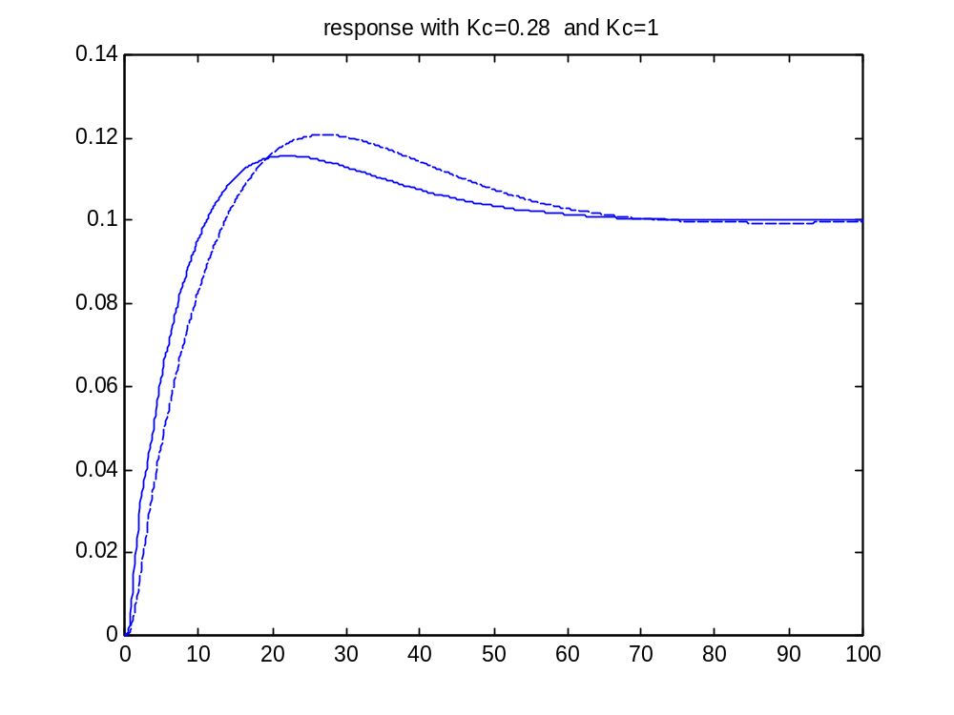
Response with K_{c}=1 and .28
K_{c}=0.28 dashed
K_{c}=1 (solid)

Slide 18
Why Frequency response is generally more capable
With root locus, choosing Kc to get a desired damping factor on “one” set of roots does not account for the presence of additional poles and zeros.
Frequency response accounts for ALL the poles and zeros and their relative positions as well.

Slide 19
Moving zeros from the origin speeds response
To choose zero locations at –1 and –0.1
Use
conv([1 1],[1 0.1]) to find
s²+1.1s+0.1, then normalize to Bode form to get
10s²+11s+1,
therefore T_{I}=11, and T_{I}*T_{D}=10 or T_{D}=10/T_{I}~0.9

Slide 20
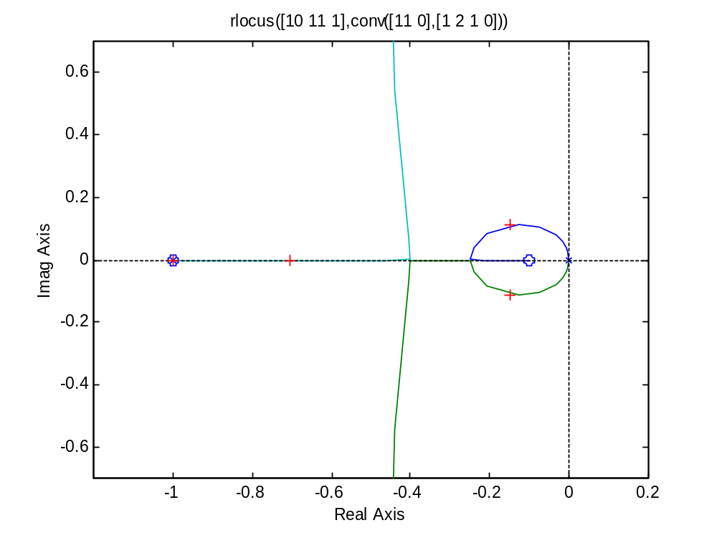
rlocus([10 11 1],conv([11 0],[1 2 1 0]))
K_{C}=0.27
Note how moving the zeros to the left “pulls” the locus to faster pole locations

Slide 21
PID controller (10s+1)(s+1)/T_{I}s portion;
T_{I}=11, T_{d}=0.9 (a pole of the plant is cancelled)
|10s+1)|
|s+1|
|1/s|
|1/11|=-21db
L(10s+1)
L(s+1)
L[1/s]
L 1/11
.01
.1
1
10
100

Slide 22
PID controller components added together
An advantage is that the “gain” increase at high frequency starts at higher frequency: means less susceptible to noise
.01
.1
1
10
100

Slide 23
1/[s(s+1)²] and PID controller T_{I}=11, T_{D}=.9
1/[s(s+1)²]
PID= control
60º PM
.01
.1
1
10
100

Slide 24
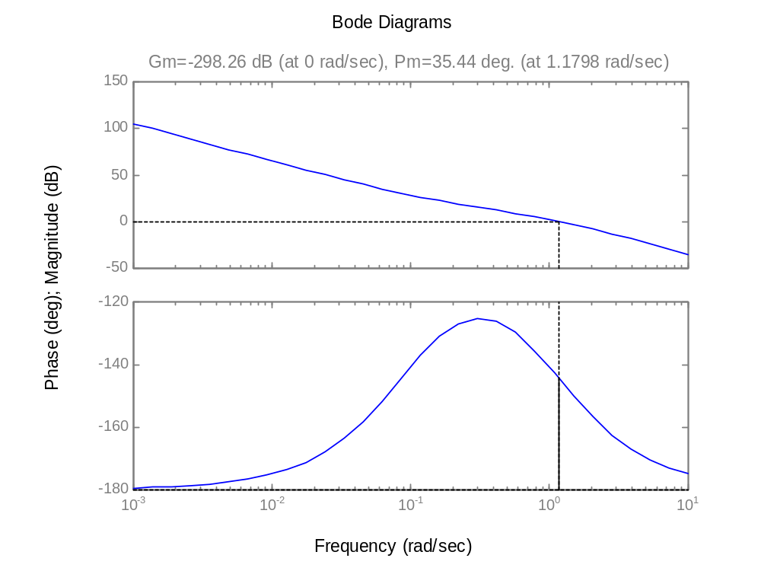
margin(2*[10 11 1],conv([11 0],[1 2 1 0]))
K_{c}=2
T_{I}=11
T_{D}=0.9
PM=35º
Kc increased until PM reduced to 35º

Slide 25
Moving zeros from the origin speeds response
To choose zero locations at –1 and –0.5
Use
conv([1 1],[1 0.5]) to find
1s²+1.5s+0.5, then normalize to Bode form to get
2s²+3s+1,
therefore T_{I}=3, and T_{I}*T_{D}=2 or T_{D}=2/T_{I}=0.67

Slide 26
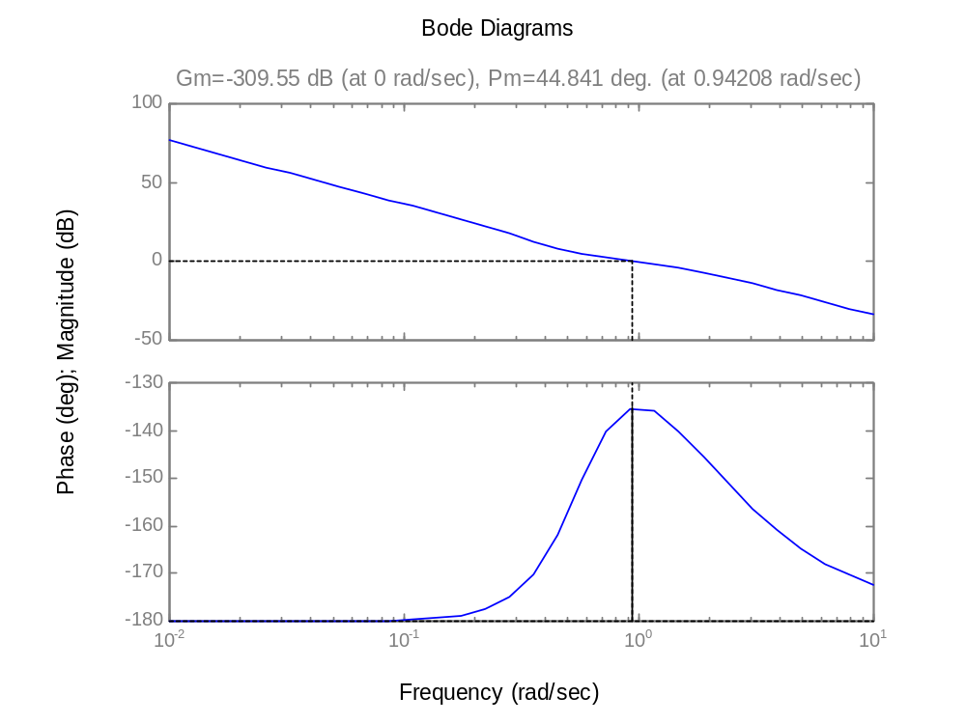
margin(2*[3 2 1],conv([3 0],[1 2 1 0]))
K_{c}=2
T_{I}=3
T_{D}=0.67
PM=45º
Kc adjusted until PM maximum

Slide 27
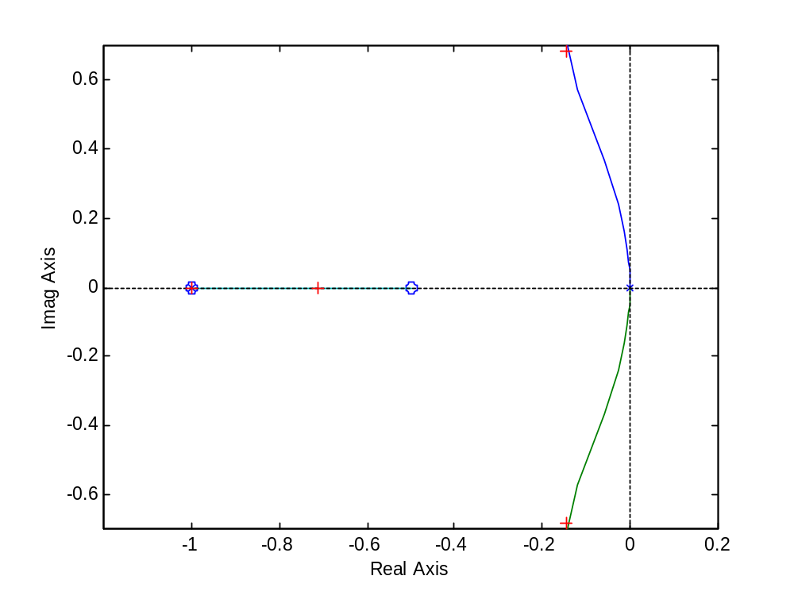
rlocus([2 3 1],conv([3 0],[1 2 1 0]))
But this time, root locus shows poor damping because the asymptotes are close to the origin
σ_{asym}= -0.25
K_{C}=1

Slide 28
Moving zeros from the origin speeds response
To choose zero locations at –0.8 and –0.2
Use
conv([1 0.8],[1 0.2]) to find
1s²+1s+0.16, then normalize to Bode form to get
6.25s²+6.25s+1,
therefore T_{I}=6.25, and T_{I}*T_{D}=6.25 or T_{D}=1

Slide 29
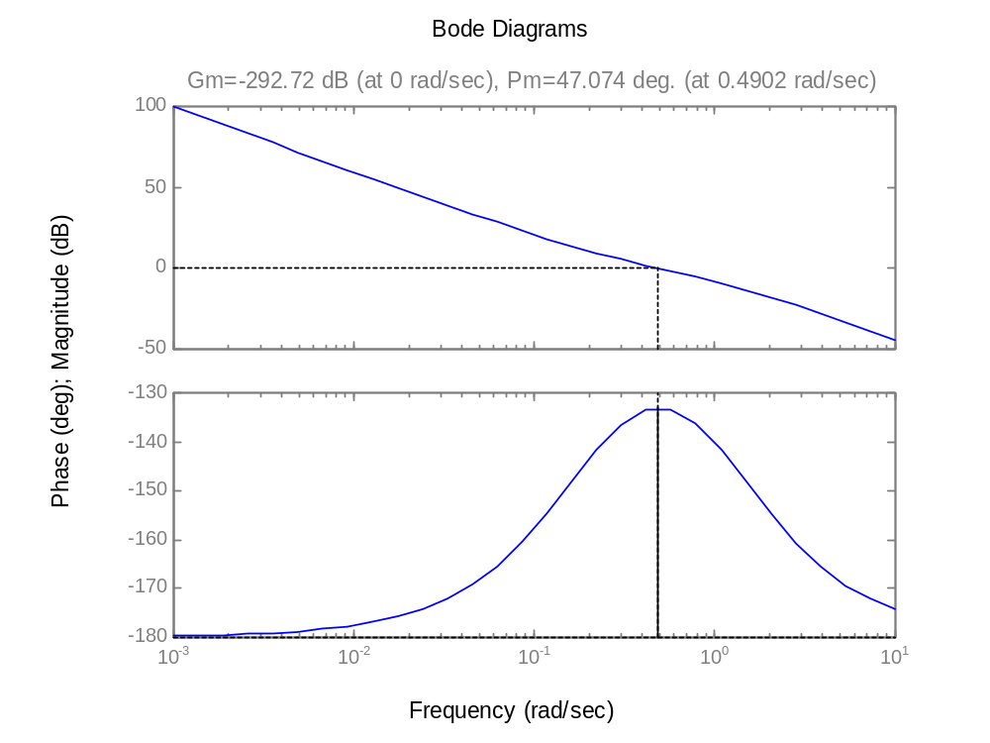
margin(0.6*[6.25 6.25 1],conv([6.25 0],[1 2 1 0]))
K_{c}=0.6
T_{I}=6.25
T_{D}=1
PM=47º

Slide 30
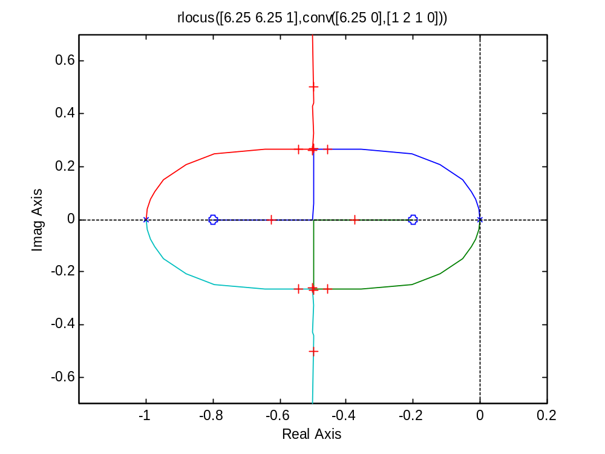
rlocus([6.25 6.25 1],conv([6.25 0],[1 2 1 0]))
K_{C}=0.78

Slide 31
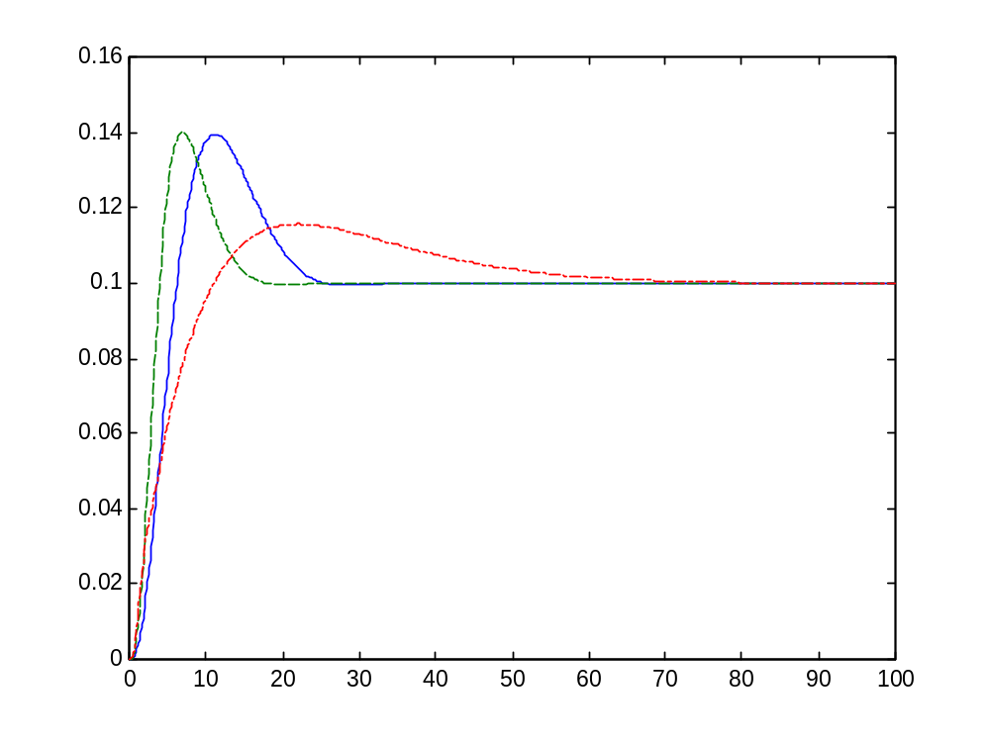
3 PID controller responses
K_{c}=0.6, T_{I}=6.25, T_{D}=1
Kc=2, TI=11, 0.9
K_{c}=1, T_{I}=20, T_{D}=5

